Slide 1

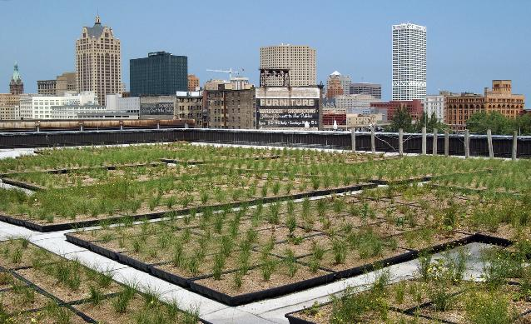
Green Stormwater Infrastructure

Slide 2
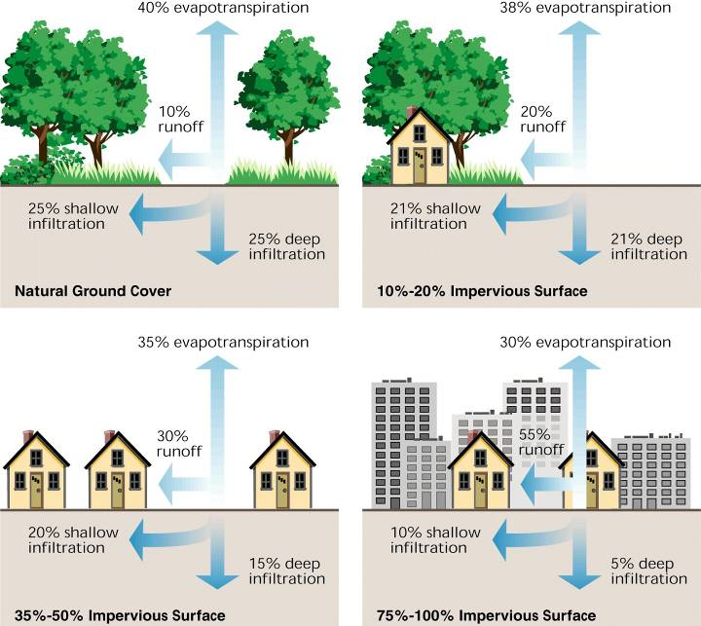
What is Stormwater?
Why does it matter?
Notes:
Stormwater really is the product of how we live, the choices we’ve made about creating built environments to live, work, manufacture, drive, fly…all the things that modern America does lots of. It’s the disruption of the natural hydrology of a site, of a neighborhood, of a community, of a watershed. Understanding the hydrological functions that we disrupt is important because, as we’ll discuss in a few minutes, real solutions to stormwater problem depend on reincorporating these functions into our build environments.

Slide 3
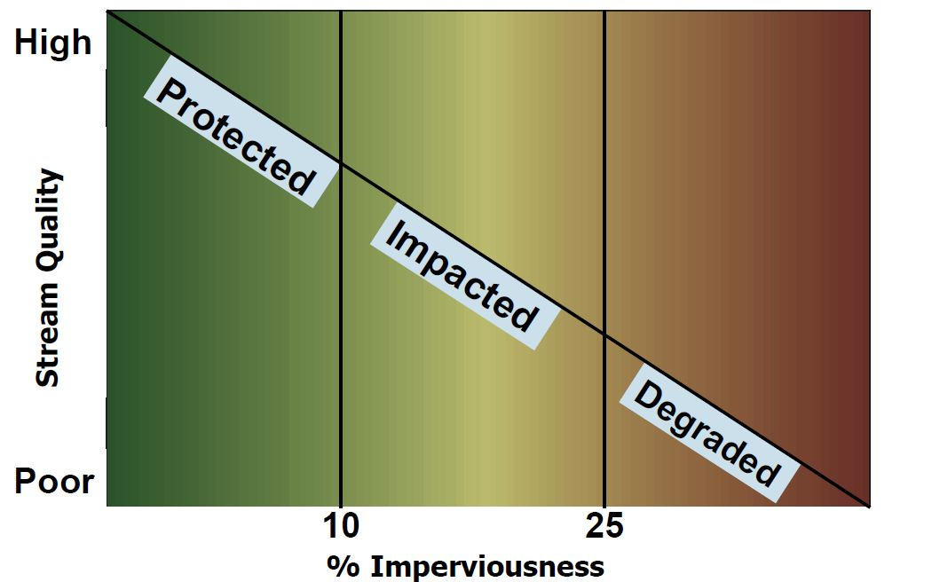
Runoff: a growing problem
Development rates outpace population growth
Development = Imperviousness = Impaired Waters
Source: California Water and Land Use Partnership
Notes:
Most significant ongoing threat to water quality. Decades of permits for factories, wastewater treatment plants, other “end of pipe” dischargers firmly in place, and improving technologies driving down impact from most commonly imagined sources of pollution. Stormwater, on the other hand, is growing:
As kind of a shared background, we’re all familiar with the inverse correlation between accelerating pace of development, the conversion of unbuilt space into built environments, and the decline in water quality (and overall stability of waterbodies)
Permits required for some, by not all, stormwater discharges, and those haven’t been particularly effective

Slide 4
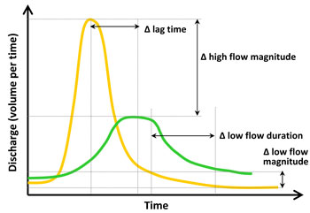
Urban vs. Rural

Slide 5
Two meanings: GSI vs GI
Definition #1: GSI
A form of wet weather management that uses vegetation, soils, natural systems, and/or engineered systems that mimic natural processes to infiltrate, evapotranspire, or recycle stormwater runoff.
Definition #2: GI
A strategically planned and managed network of natural lands, working landscapes, and other open spaces that conserves ecosystem values and functions and provides associated benefits to human populations.

Slide 6
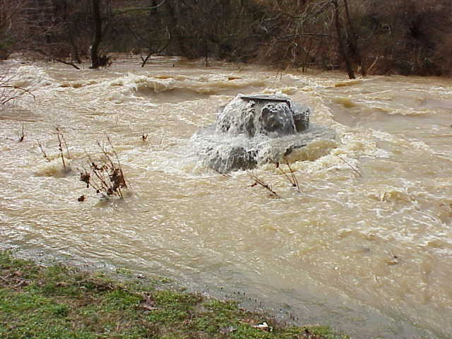
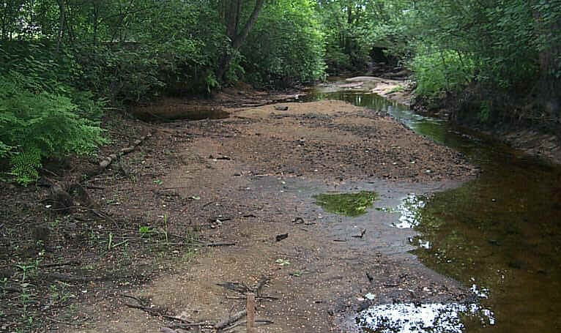
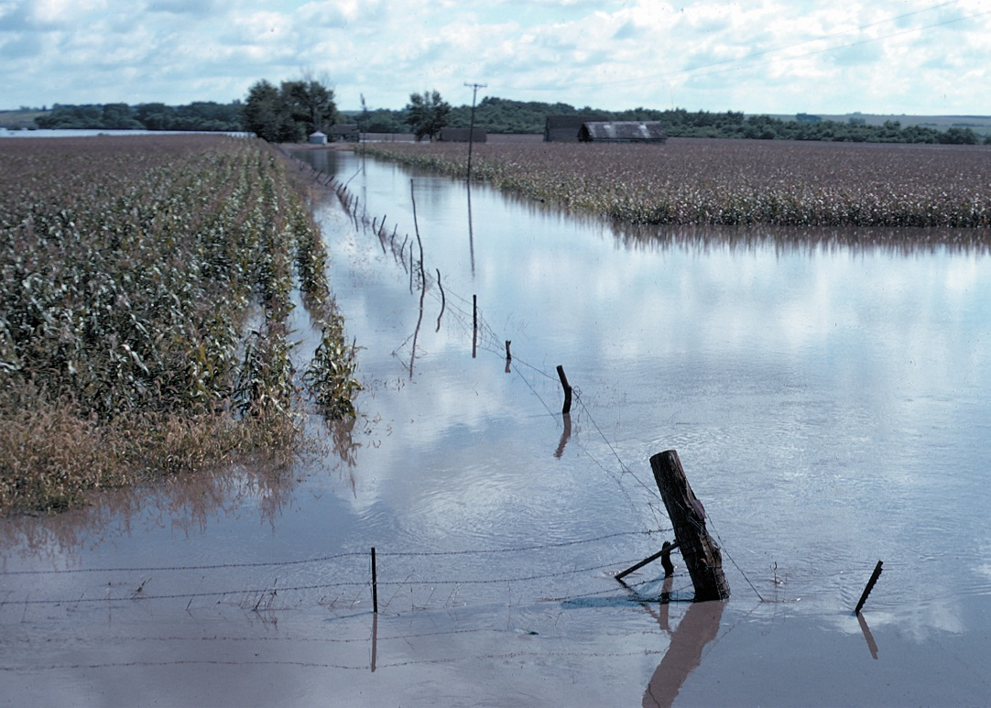

Hydrological Impacts of Increased Runoff
Lower baseflow
More frequent flooding
Increased flood peaks
Credit:NRCS

Slide 7
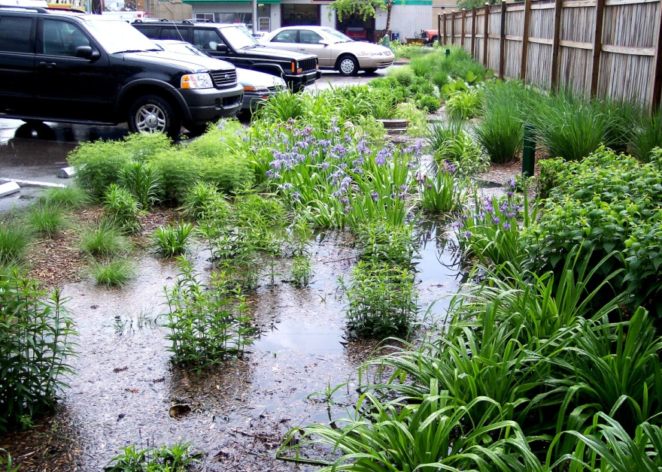
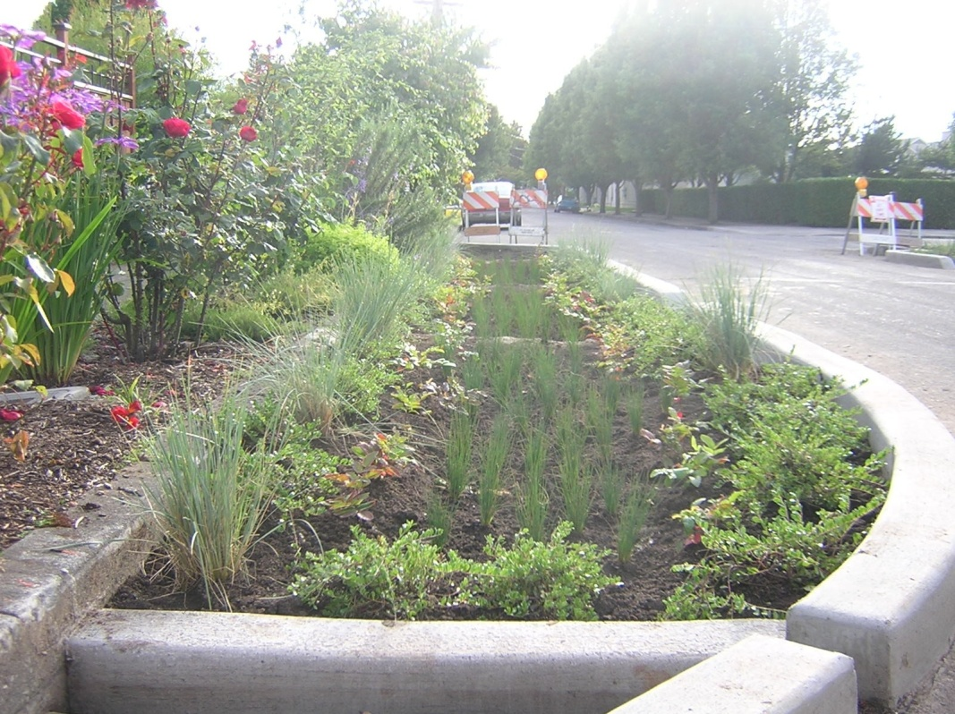
Bioretention
Popular retrofit option
Contributing drainage area should be less than 2 acres
Surface area 4-7 percent of drainage area.
Soils do most of the work
Overflows and underdrains used
Focuses on infiltration

Slide 8
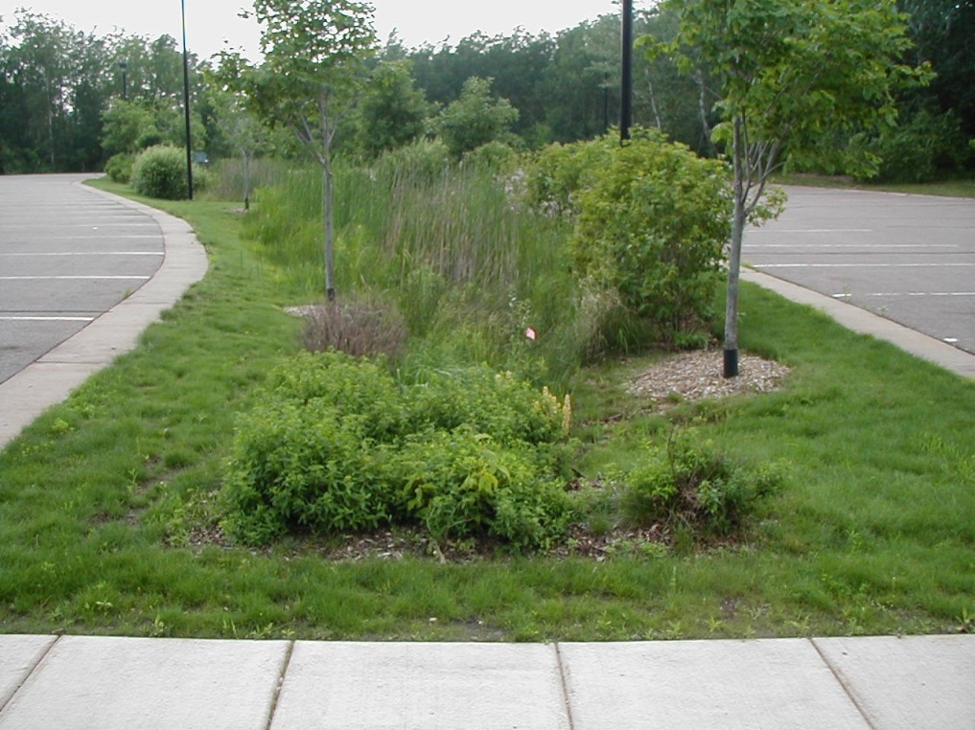
Bioswales
Infiltration and transport
Drainage are should be 0.5 acres or less
Depth of ponding should be less than 6 inches, but may be up to 12 if it won’t damage plants

Slide 9
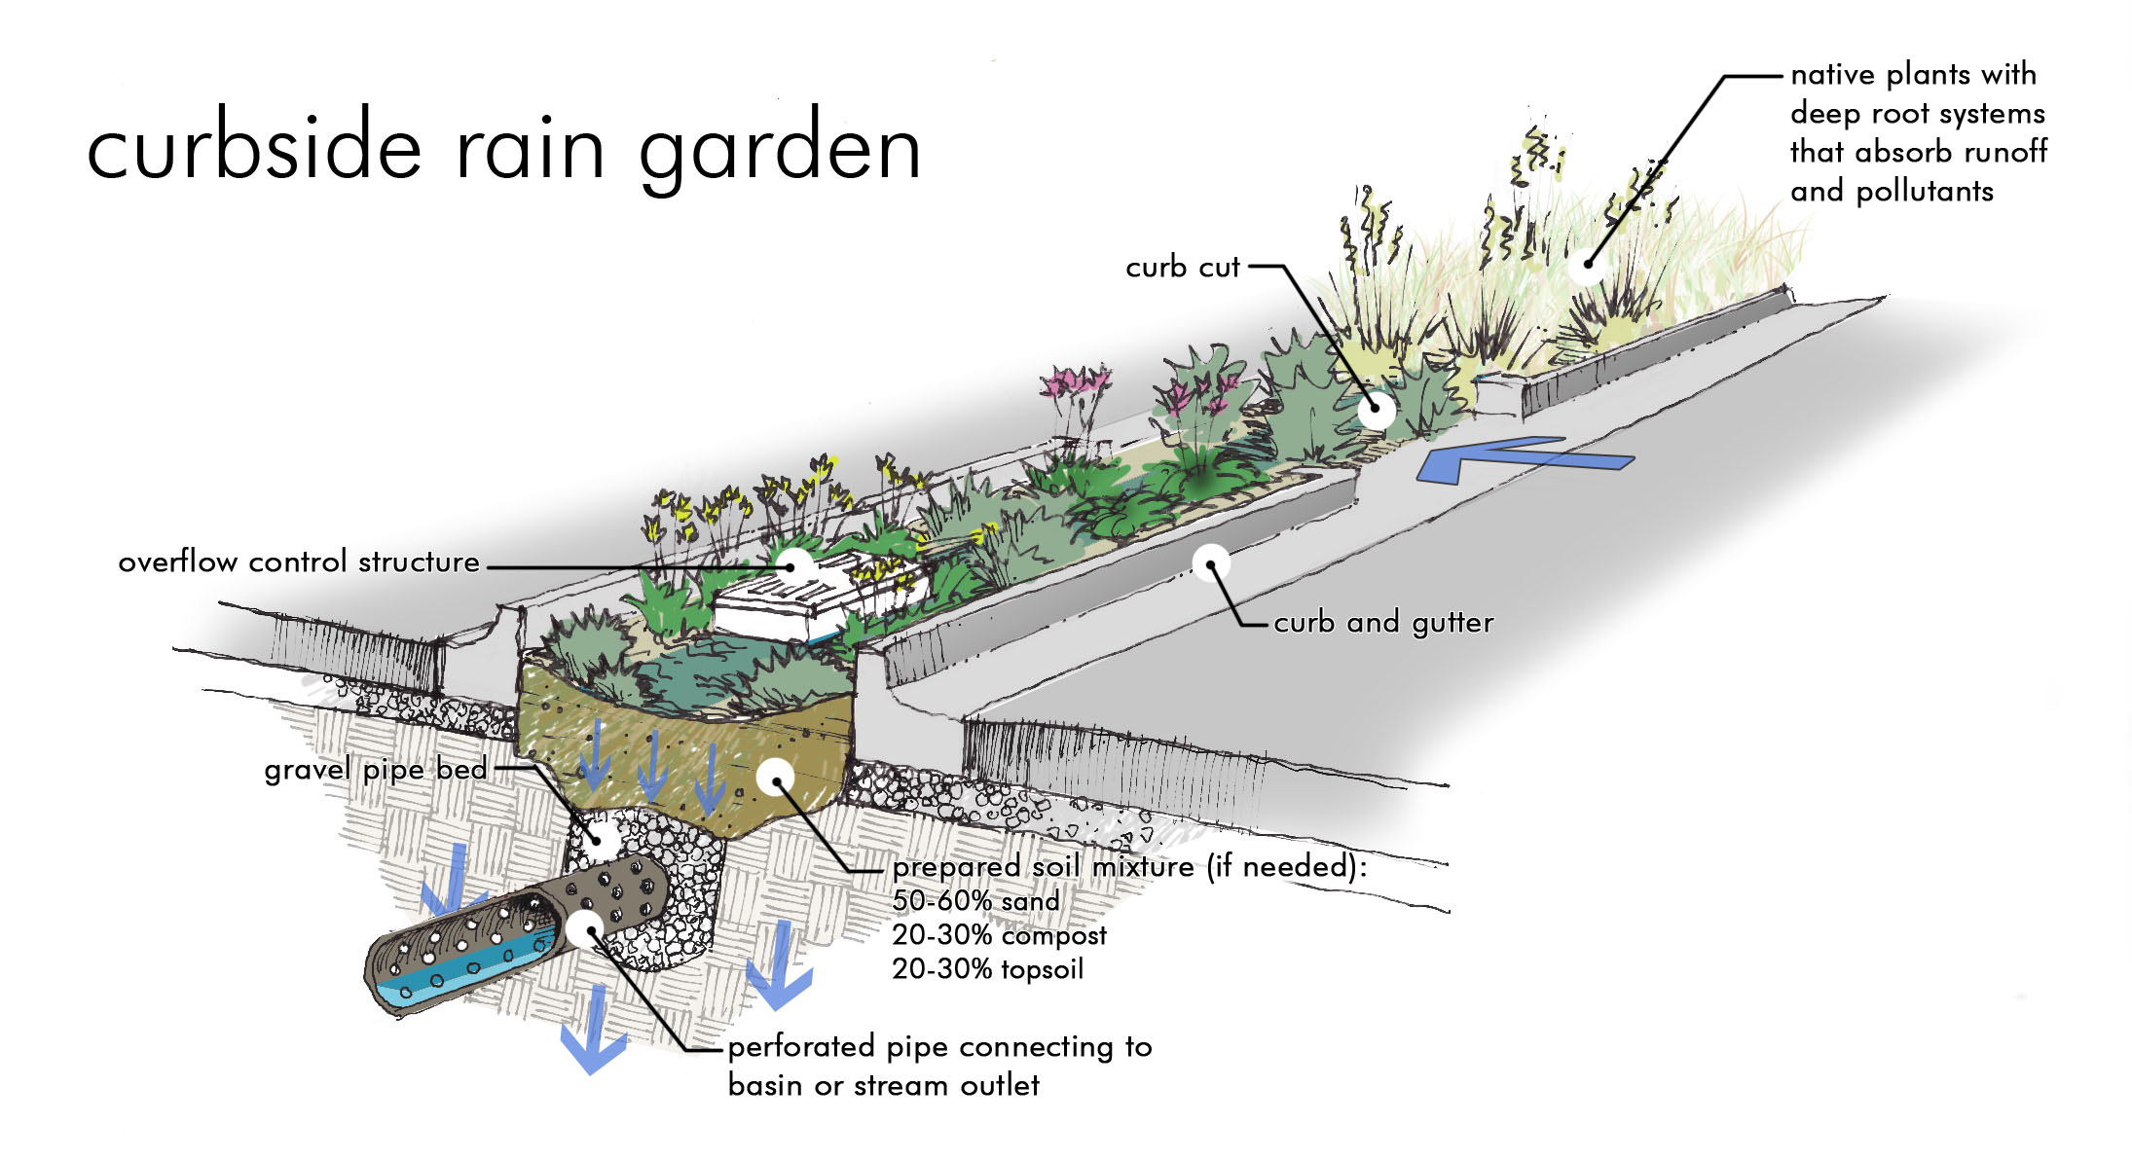
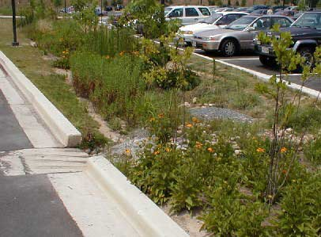
Examples of Green Stormwater Infrastructure
Bioswales
  Existing Roadside Swales
  Drainage Ditches
  Street Side
  Parking Lots
http://bigwalnutwatershed.org/images/bioswale%20enlargement.jpg
Parking Lot, Monroe Co. IL/ American Rivers
Notes:
Vegetated channels that provide treatment and retention as they move stormwater from one place to another. Their design makes them ideal for linear applications such as….
Involve the use of engineered soil mixes and often have an underdrain

Slide 10
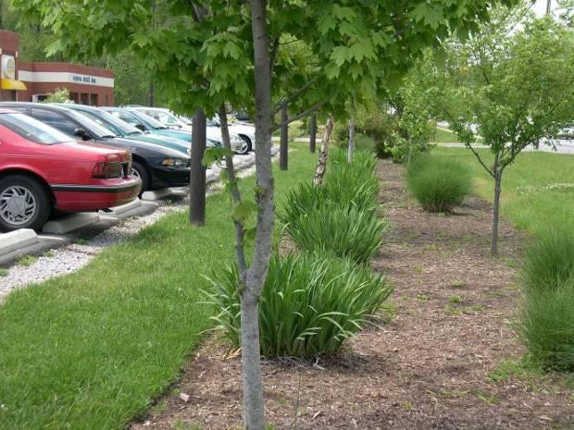
Filter Strips
Vegetative filtering
Prevents sediment and other materials from clogging other BMP’s
Slope at 2-5 %
Limit flow length to 100 ft or less (to prevent channeling)

Slide 11
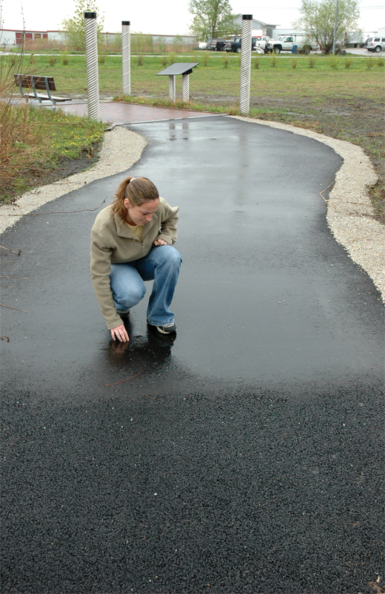
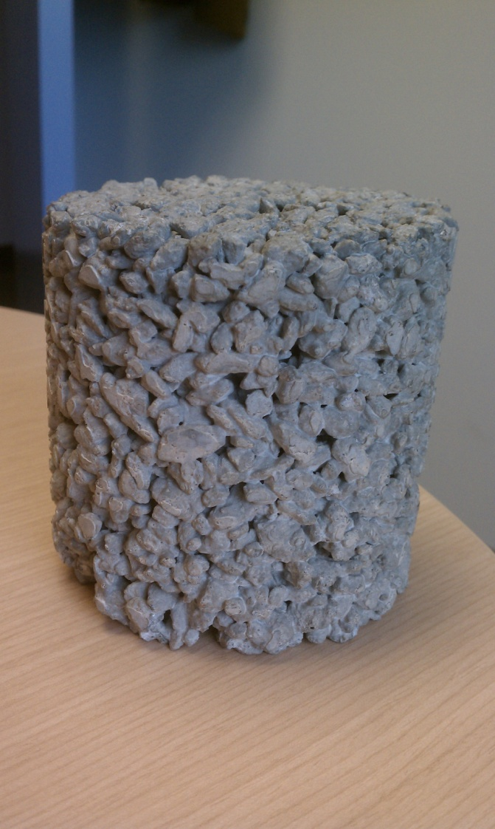
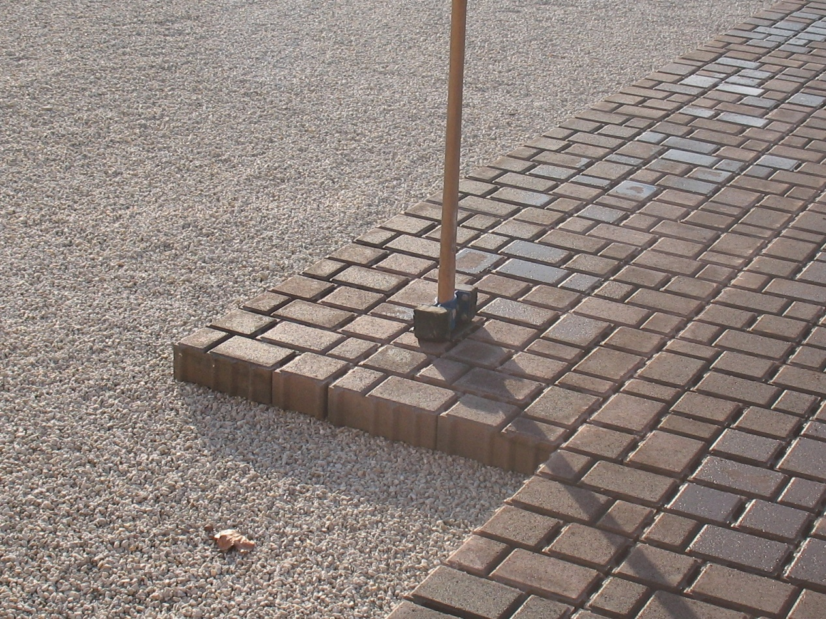
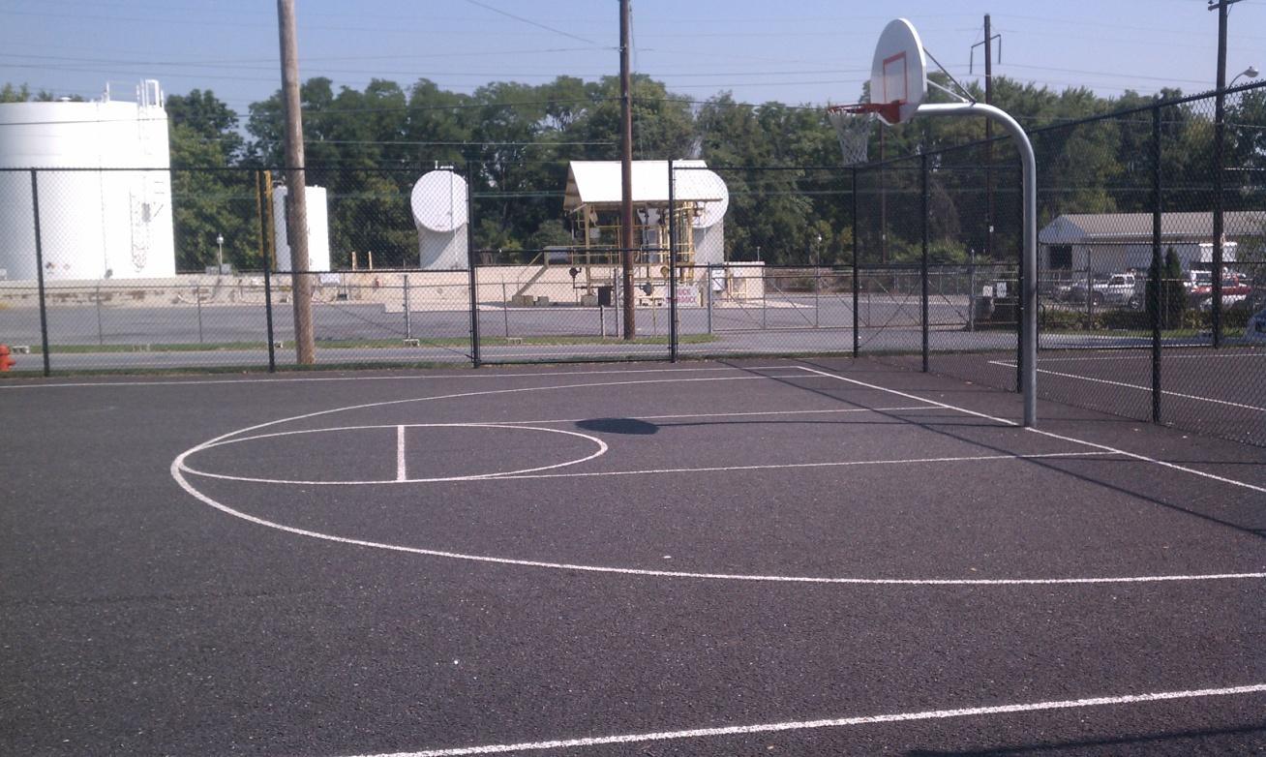
Permeable Paving

Slide 12
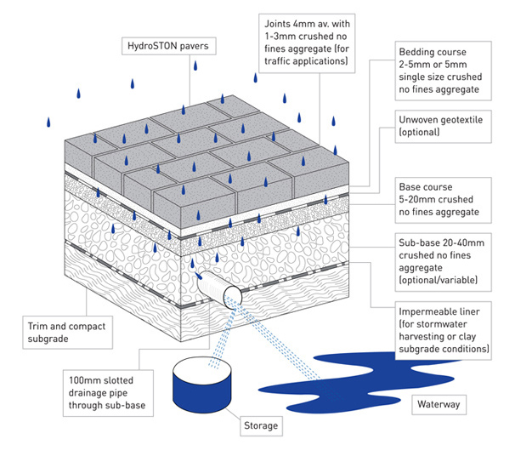
Permeable Paving
Parking areas, low speed traffic, pedestrian areas.
Great for cold environments
Aggregate subbase typically 1 or more feet deep.
Some filtration properties too
(http://hydroston.com.au/design/)

Slide 13
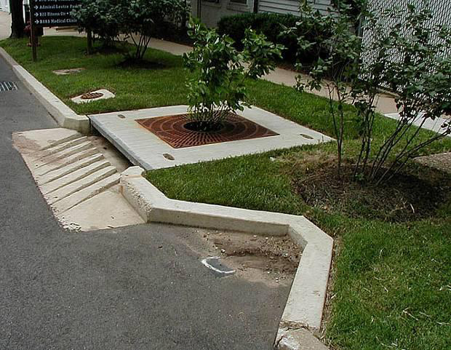
Tree Boxes & Street Trees
Used to filter water before entry into system.
Usually ¼ acre drainage area (6x6 box)
Good retrofit options
Mature trees are exceptional at capture and infiltration.

Slide 14
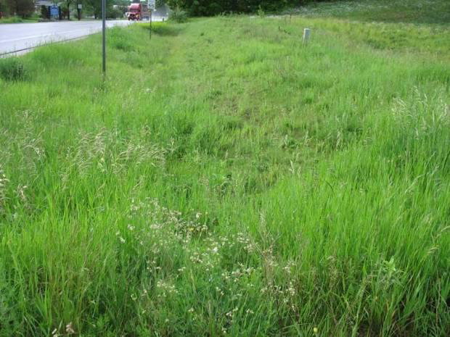
Infiltration Trench
Popular for transportation rights of way
Drainage area 2 acres or less with 5% slope
Larger aggregate subbase typically used.

Slide 15
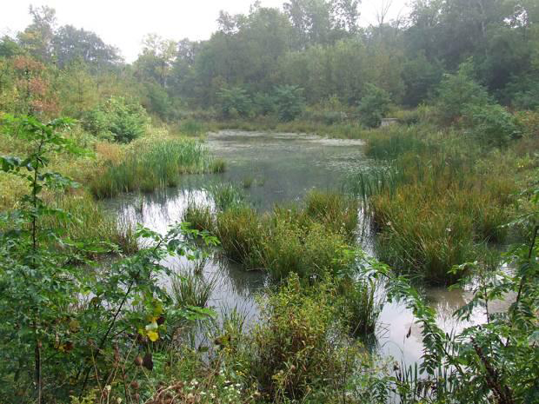
Stormwater Wetlands
Optimal for nutrient removal
Attenuates flow
Drainage area of 5-10 acres
Siting should avoid conditions for stagnant water.

Slide 16
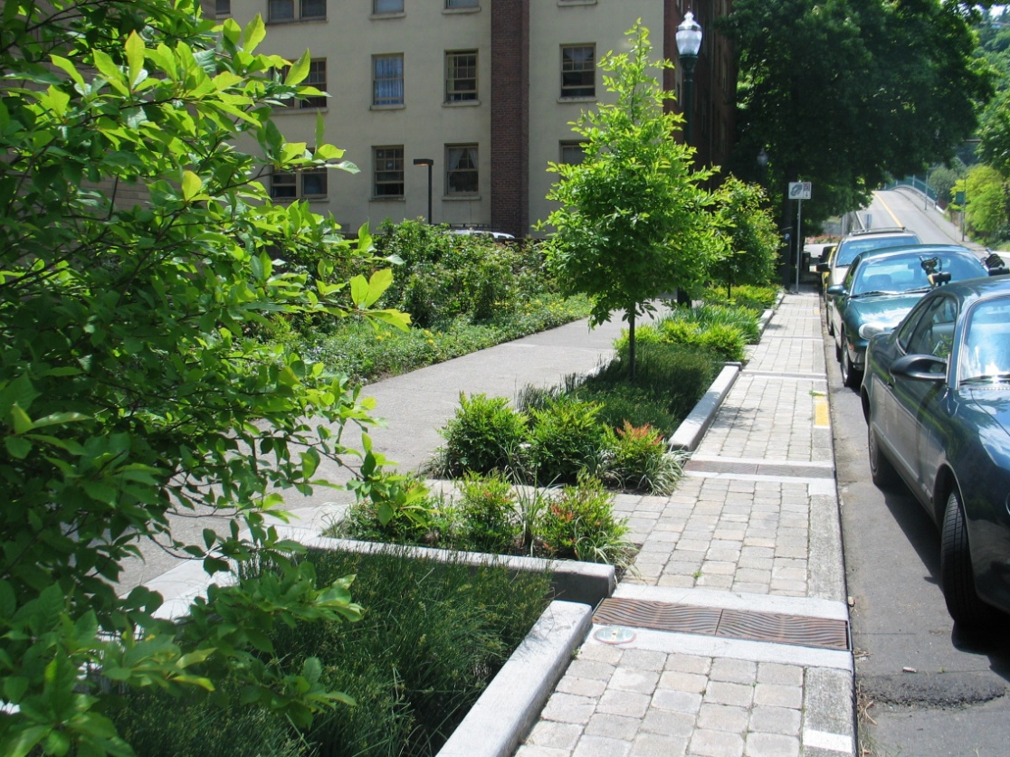
Combinations
Green Streets, etc.
Using multiple BMP’s in circuit.
Adds aesthetics while increasing drainage area
Cost effect with street renovations.
Can be used for traffic calming.

Slide 17
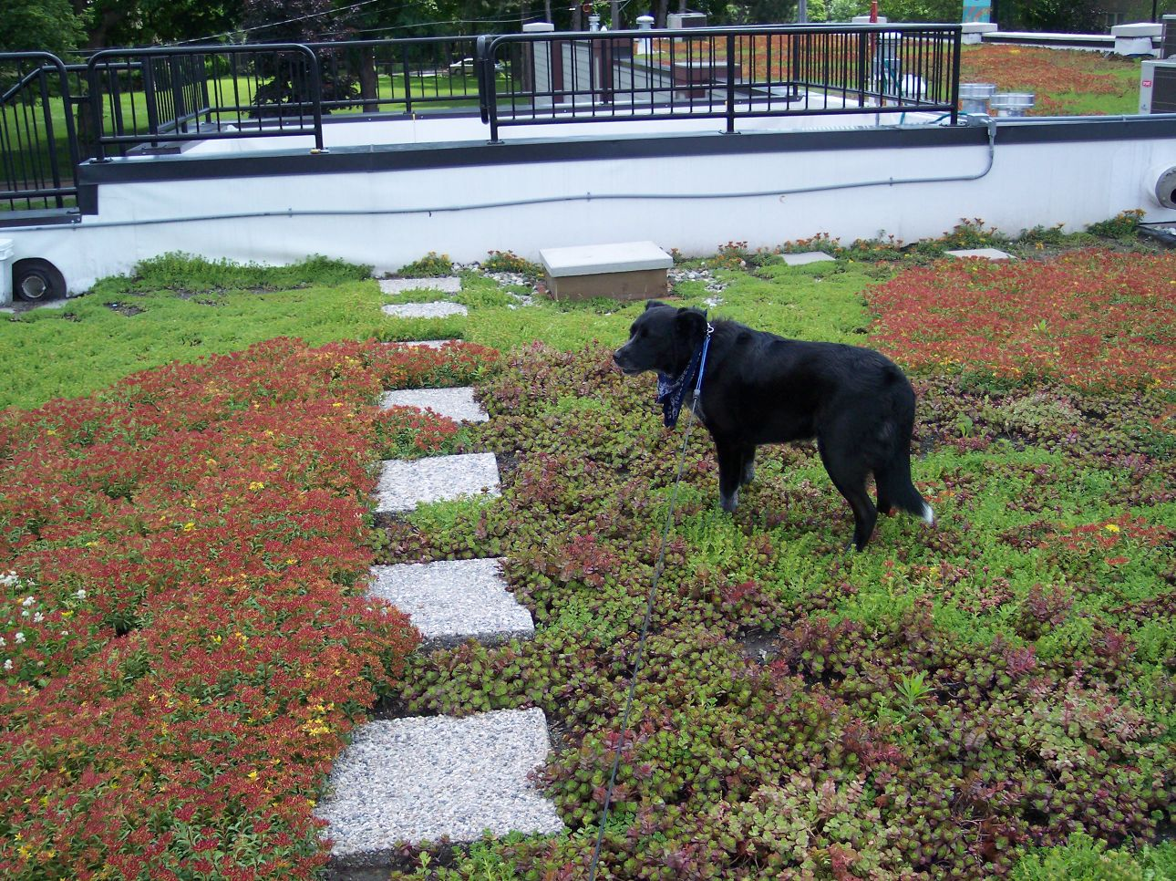
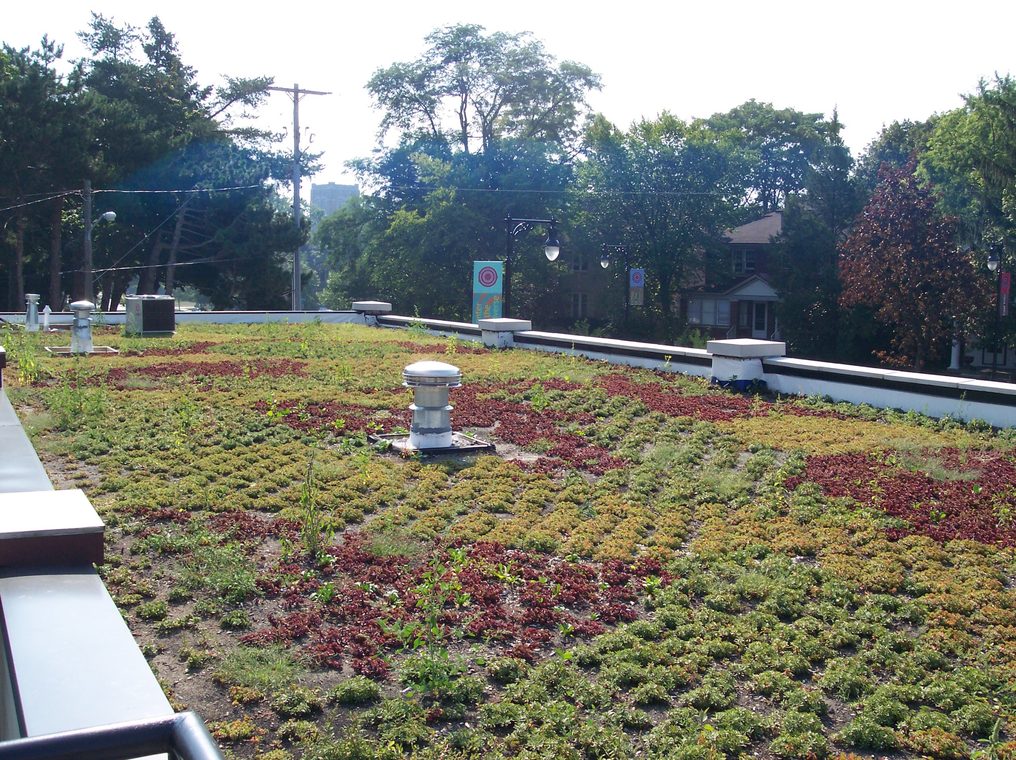
Green Roofs

Slide 18
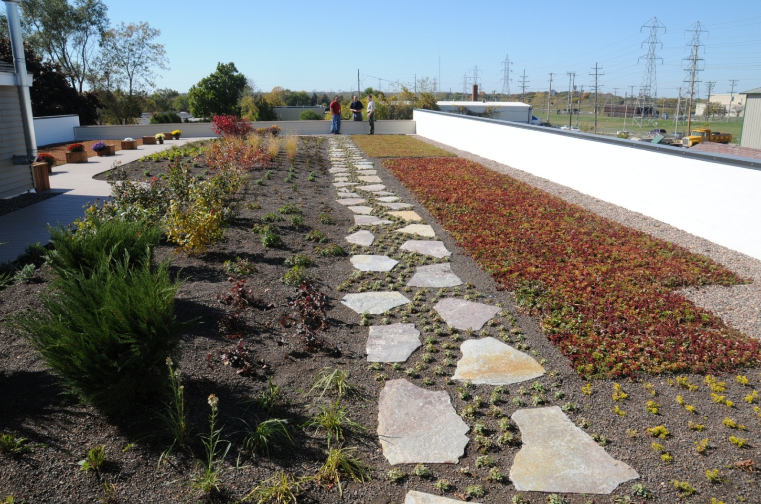
Green Roofs
Variety of different products
Intensive vs. Extensive
Energy saving benefits & roof life extension.
Costs are coming down.
Generally same weight as roof ballast.

Slide 19
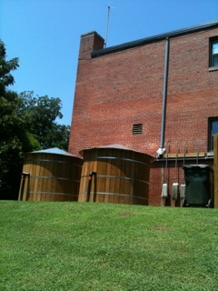
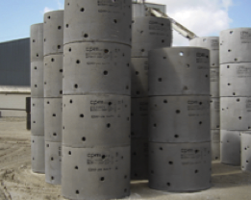
Other examples of Green Stormwater Infrastructure
Stormwater Drainage Wells
  Parking Lots
  Underneath a variety of paved and unpaved surfaces
Cisterns/ Raleigh, NC/ Katherine Baer
Rainwater Harvesting
  Terminal Entrance/ Exit Area
  Flower Beds
  High Pedestrian Traffic Areas
City of Philadelphia/ Green Streets Design Manual, p36
Notes:
Rainwater harvesting systems collect and store rainfall for later use. Opportunity to collect a great deal of water for reuse. For every 1000 SF of roof footprint, In a 1” rain, over 600 gallons of water can be captured. Cisterns are also often the first step in a treatment train of green infrastructure systems.
Stormwater drainage wells are a concept that have been around for a long time. They are under ground water storage tanks that receive water from pre-treatment systems and other conveyences and allow it to slowly infiltrate back in the surrounding soils through perforations in the the tanks which can be set at varying heights dependent on the situations of the surround soils.

Slide 20
Economics of Green Infrastructure
Generally less expensive than conventional in new development
Studies have shown property value increases of up to 5%
Smaller pipe diameters help in cost reduction
Multiple additional benefits, such as aesthetics, urban heat reductions, cleaner air, etc.

Slide 21
Valuation Tool- CNT & AR
Notes:
CNT VALUATION TOOL

Slide 22
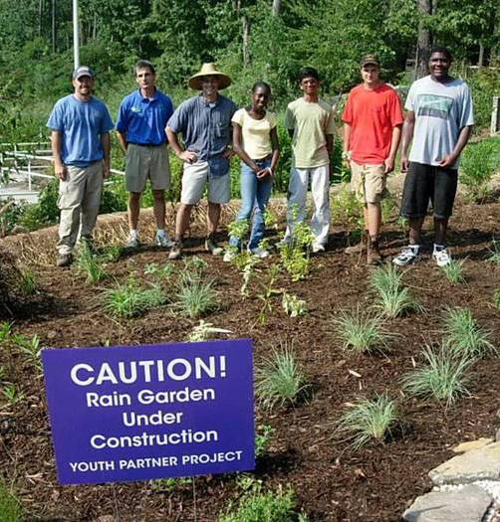
Turner Field Recommendations
Manage first 1.8” of rainfall with green infrastructure (95% of the storms in Atlanta)
Keep water out of the undersized sewer
Reuse the water, or let it soak into the ground
Ability to capture 3.6 million gallons per storm onsite.

Slide 23

Core Area Feasibility Assessment
Core Area—70 acres
Harvest rainwater from all buildings
Build new roads with permeable pavement
Retrofit existing roads with bioretention
Include bioretention in all parks

Slide 24
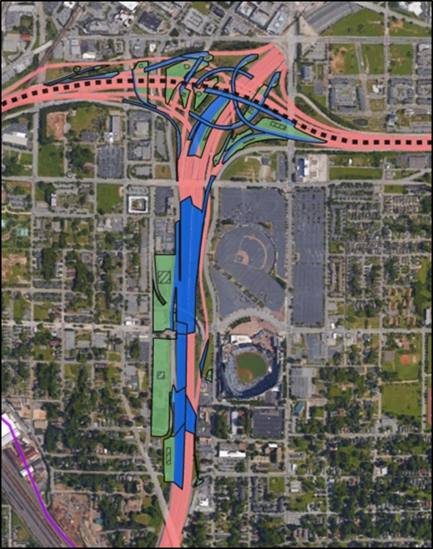
Interstate Feasibility Assessment
Interstate—30 acres
Matched up interstate areas with nearby low-lying green space
Using bioretention wherever possible
Potential to manage stormwater from 1/3 of the interstate surface within the LCI

